Slide 1
AWS CloudOps Agent
Built with AWS Strands Agent SDK and Amazon Q

Slide 2
Contents
Introduction
Architecture
Cost Estimation

Slide 3
Introduction
Strands Agents – an Open-Source AI Agent SDK

Slide 4
Core concepts of Strands Agents
The simplest definition of an agent is a combination of three things
Model
Tools
Prompt
The agent uses these three components to complete a task, often autonomously
Model
Prompt
Agent
Tools

Slide 5
Strands Agents main components
1 Model
Strands offers flexible model support.
You can additionally define your own custom model provider with Strands. (Ollama, Open AI, Anthropic, etc.)
2 Tools
You can choose from thousands of published Model Context Protocol (MCP) servers to use as tools for your agent.
3 Prompt
You provide a natural language prompt that defines the task for your agent, such as answering a question from an end user.

Slide 6
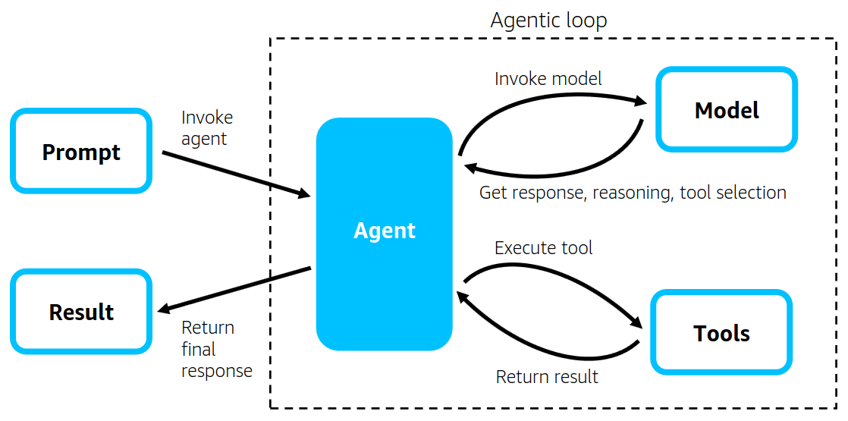
Strands Agents main components
Introducing Strands Agents, an Open Source AI Agents SDK | AWS Open Source Blog

Slide 7
Architecture
An initial overview of the design system

Slide 8
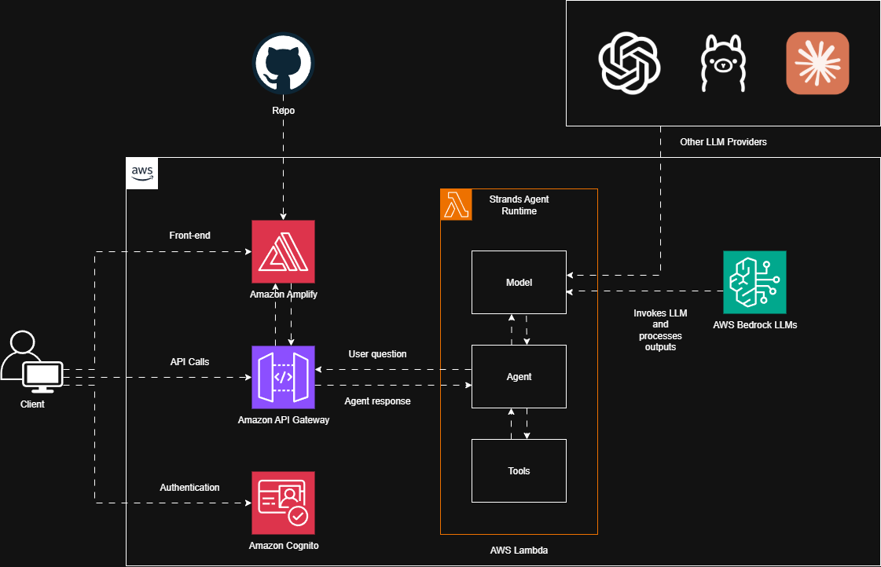
Architecture

Slide 9
Cost Estimation
Summary of ASW expenses

Slide 10
Cost Estimation
Service | Purpose | Description
Amazon Amplify | Front-end | Hosting: ~$1-15/month (depends on traffic) Build minutes: $0.01 per build minute Data transfer: $0.15/GB after 15GB free tier
Amazon Cognito | Authentication | User pools: Free for first 50,000 MAUs, then $0.0055 per MAU Identity pools: Free for first 50,000 identities, then $0.15 per 10,000
Amazon API Gateway | API | REST API: $3.50 per million requests WebSocket: $1.00 per million messages Free tier: 1 million requests/month for 12 months
AWS Lambda | Agent Runtime | $0.20 per 1M requests $0.0000166667 per GB-second of compute Free tier: 1M requests + 400,000 GB-seconds/month
Amazon Bedrock | LLM Provider | Varies by model (Claude, Titan, etc.) Input tokens: ~$0.003-0.015 per 1K tokens Output tokens: ~$0.015-0.075 per 1K tokens
Typical Small-Medium App Estimate: $50-500/month

